Slide 1
Building a Node.js web app using GCP
By Altotech

Slide 2
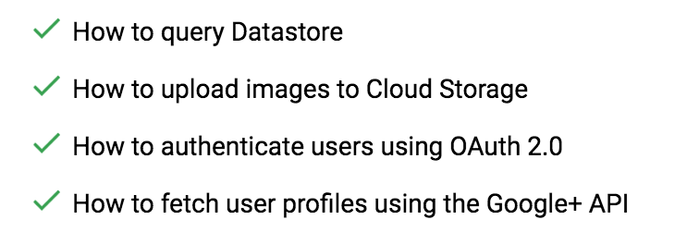
What you’ll learn

Slide 3
Gist for copy code
https://gist.github.com/h4tl2/4404cb8368bcc914983de13cf58416b8

Slide 4
Step 1: Setting it up
you'll need to enable billing in the Developers Console
https://console.developers.google.com/billing
Don’t worry, New users of Google Cloud Platform are eligible for a $300 free trial.

Slide 5

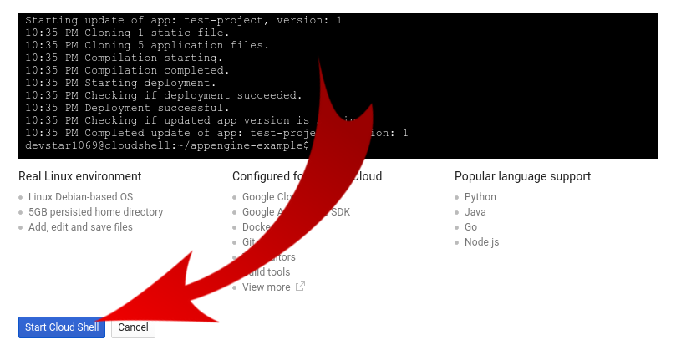
Step 2: Login to the Shell
Click on this icon on the top right corner

Slide 6
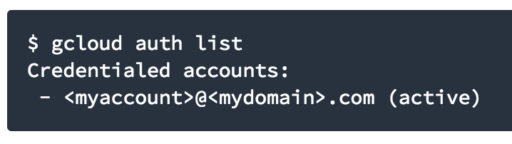
Step 2: Login to the Shell
Type “gcloud auth list”

Slide 7
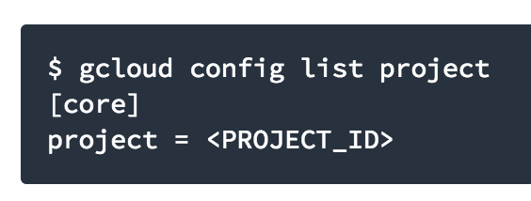
Step 2: Login to the Shell
Type “gcloud config list project” to check the configuration.

Slide 8
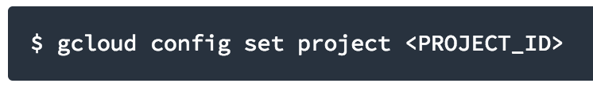
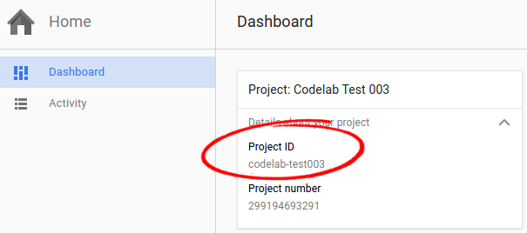
Step 2: Login to the Shell
If for some reason the project is not set, simply issue the following command :

Slide 9
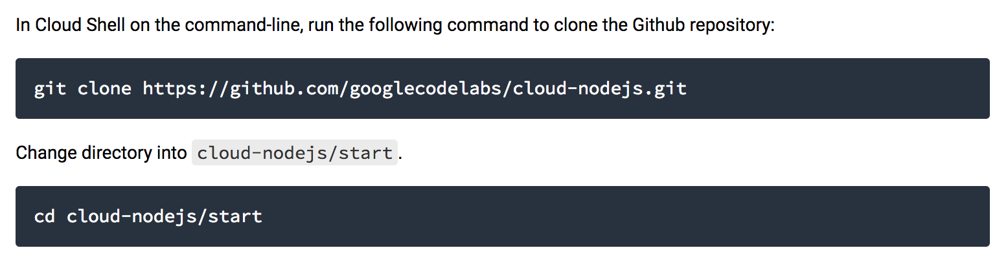
Step 3: Clone the example code

Slide 10
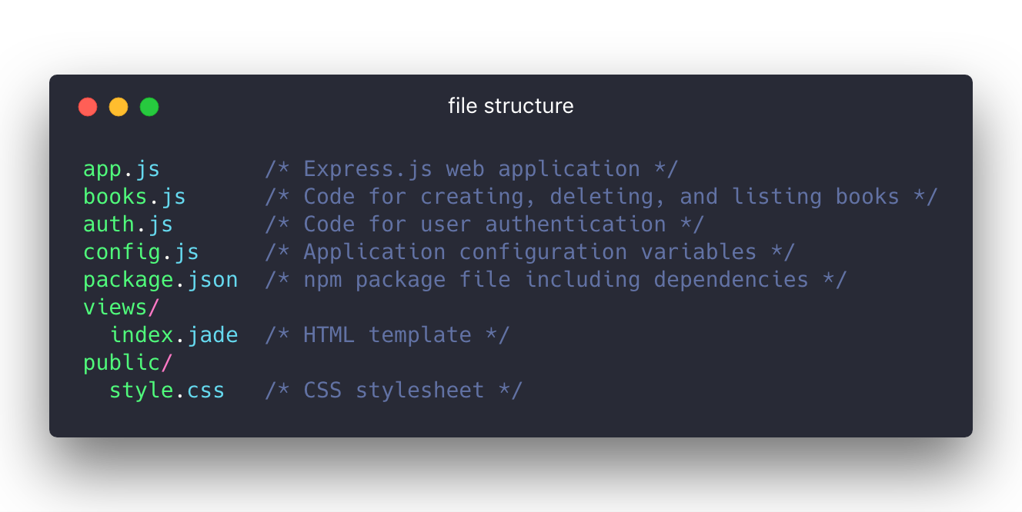
Step 4: Install the package

Slide 11
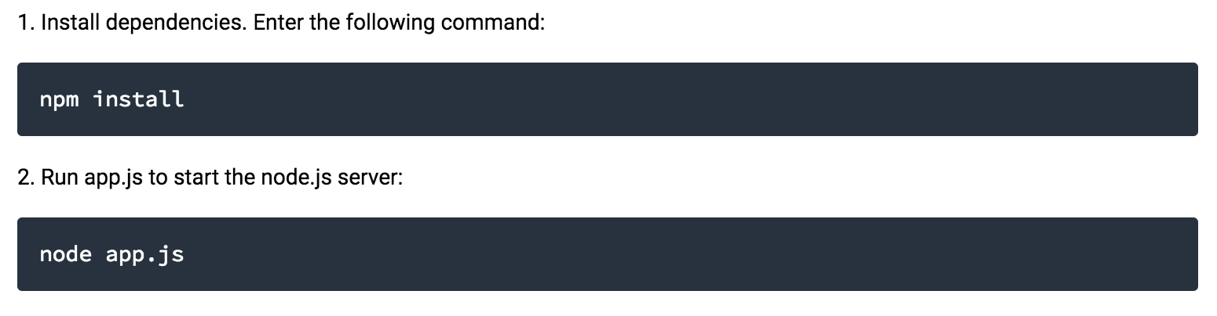
Step 4: Install the package

Slide 12
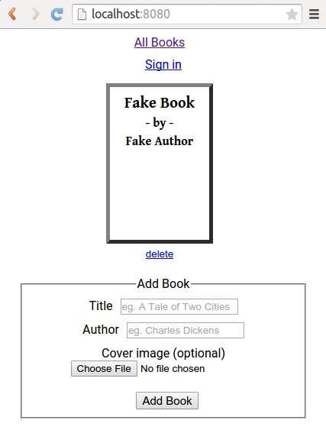
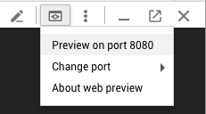
Step 5: Preview the app

Slide 13
Step 6: Create Credentials
Go to API & Services > Credentials
Click Create credentials
Select Service account key
Select Compute Engine default service account, make sure the key type is JSON.
Then click CREATE button
Open the <project name>-<hash string>.json file then copy
Back in the cloud shell in the “cloud-nodejs/start” copy and paste into a new file call key.json

Slide 14
Step 7: Enable Datastore API
Under APIs & Services, click Enable APIs and Services and search for "Cloud Datastore API"
Click on Cloud Datastore API
Click Enable (at the top of the page).

Slide 15
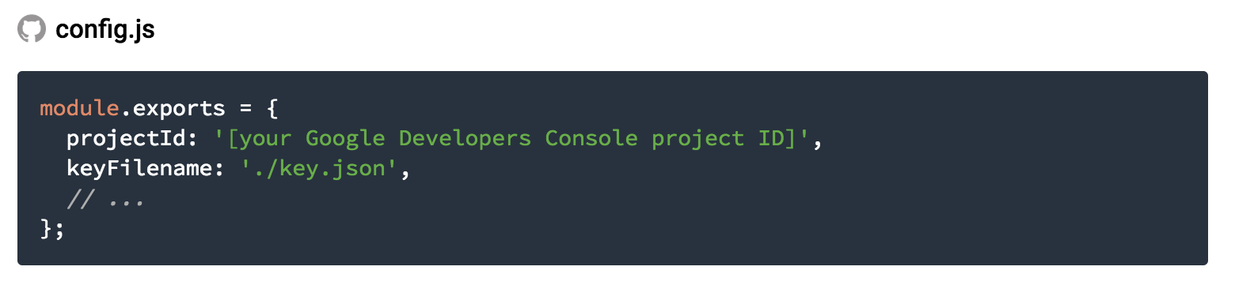
Step 8: Update config variable
Edit config.js

Slide 16
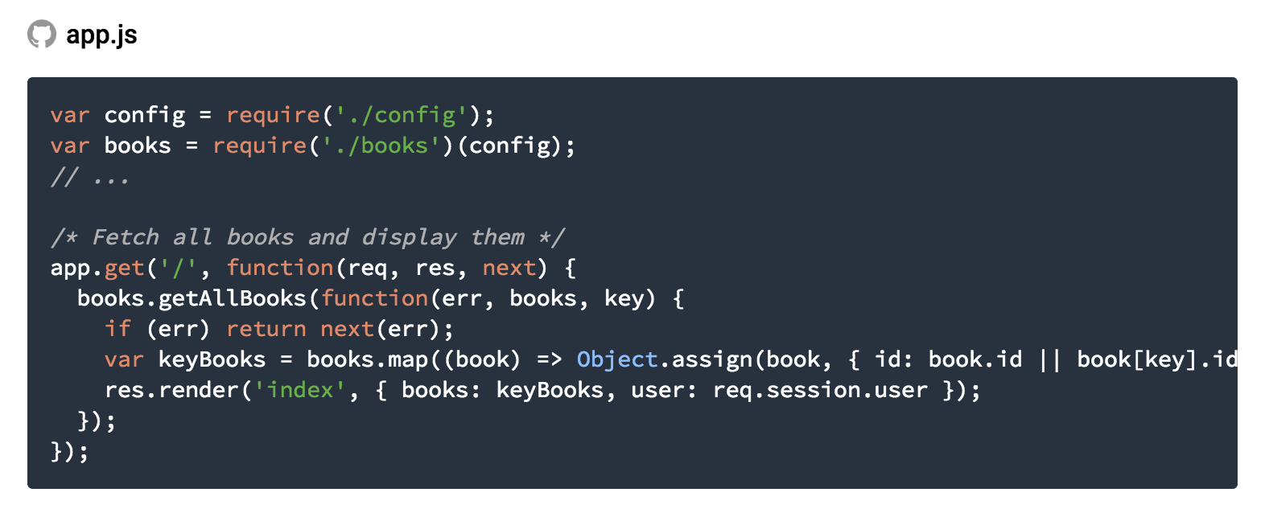
Step 9: List all books from the datastore
Books are retrieved by calling books.getAllBooks from the books module.

Slide 17
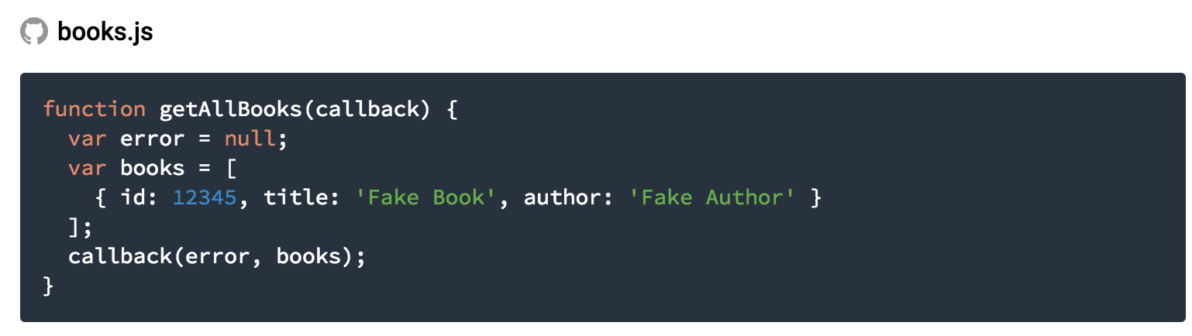
Step 9: List all books from the datastore
We need to implement this to get data from Datastore

Slide 18
Step 9: List all books from the datastore
Configure datastore

Slide 19
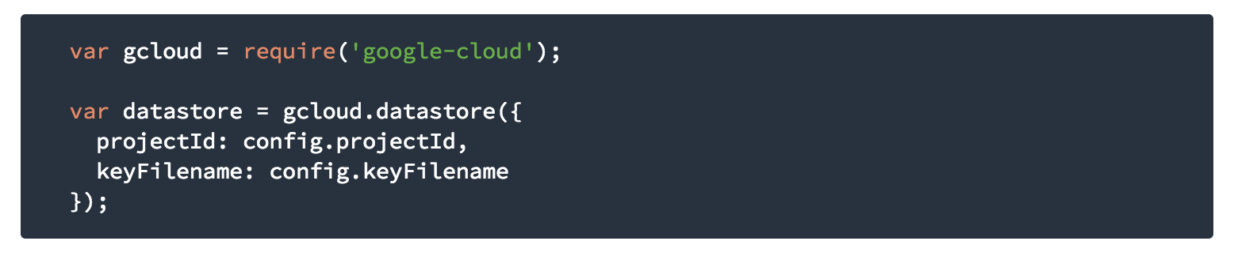
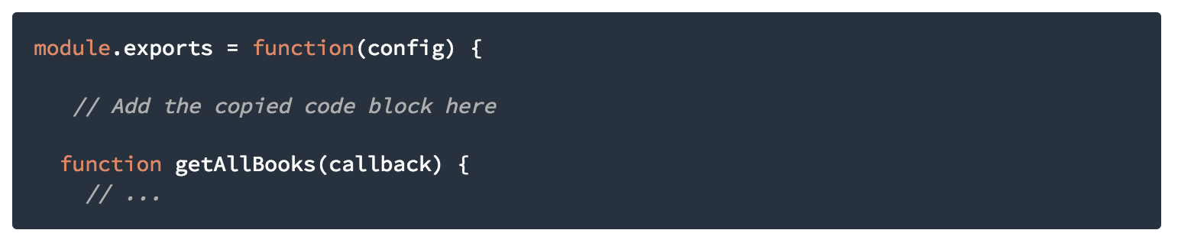
Step 9: List all books from the datastore
Copy this
Paste in this book.js
The gcloud.datastore object allows you to interact with Google Cloud Datastore
The projectId and keyFilename are read from the config.js file that you edited earlier.

Slide 20
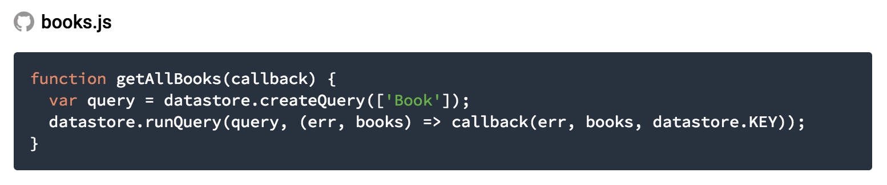
Step 9: List all books from the datastore
Change the old getAllBooks function to this

Slide 21
Step 10: Add Entity
To test the Datastore query and see data displayed, add a Book entity from the Google Cloud Console.
Open a new web browser tab and visit Google Cloud Console
Select to your Google Cloud Platform project using the dropdown at the top.
From the left navigation menu under "Storage", click Datastore
Click Create Entity

Slide 22
Namespace: Leave this set as [default]
Kind: Select Book from the dropdown. If Book is not present, type it in manually and add the following properties to the entity. (All of these properties should be Strings.)
Author
createdBy
Description
imageUrl
publishedDate
title
Key Identifier Type: leave the default value of "Numeric ID (auto-generated)"
Under the property list, change the value of the title property to A Tale of Two Cities
Then, change the value of the author property to Charles Dickens
Click Save

Slide 23
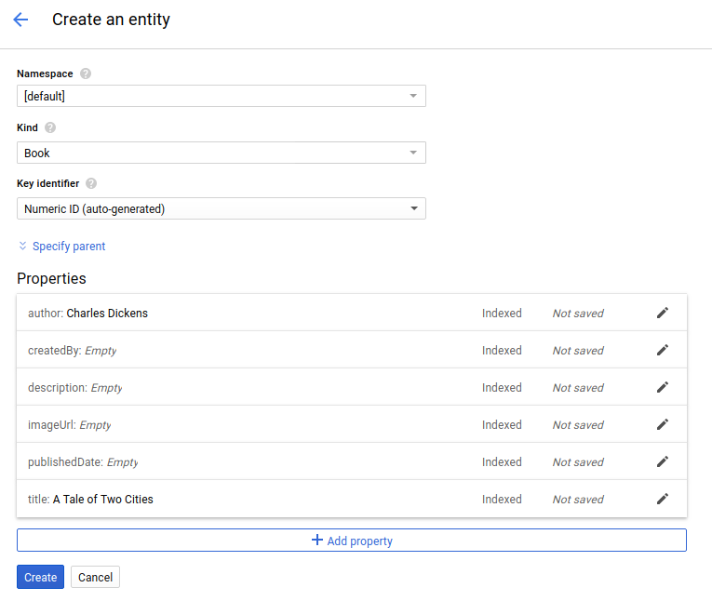

Slide 24
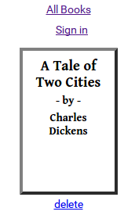
Step 11: Preview the app again
Now you should see something like this

Slide 25
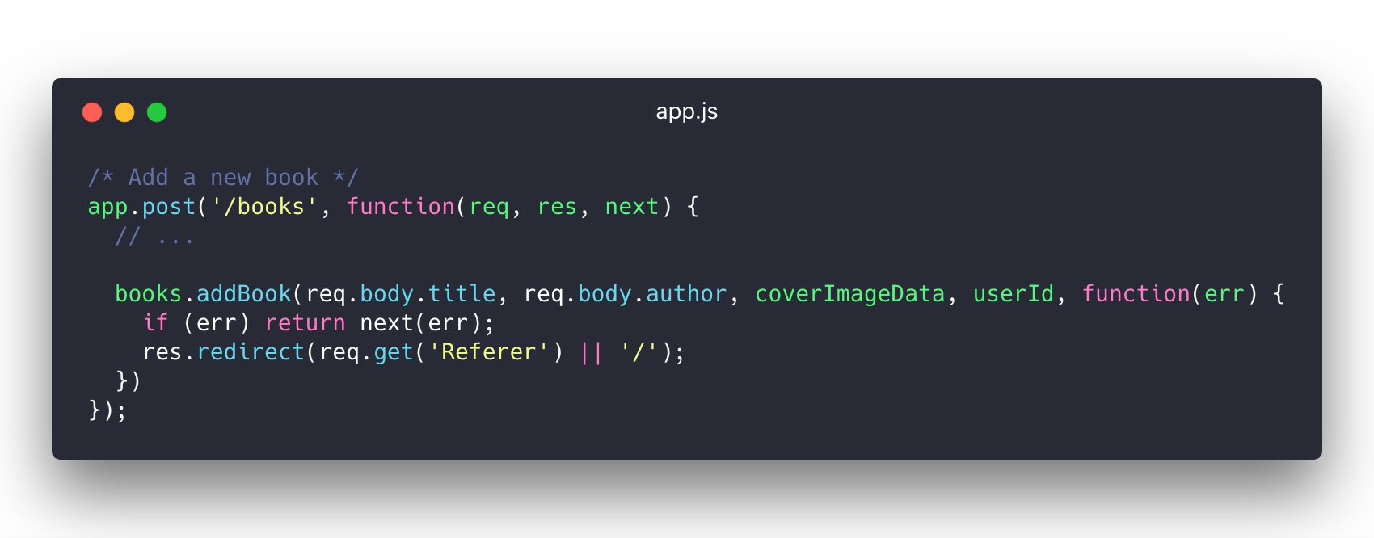
Step 12: Create book
Adding a new endpoint for create book

Slide 26
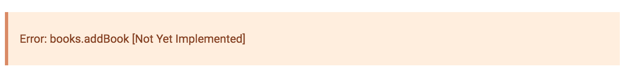
Step 12: Create book
Currently, if you try to add a book, you receive an error:

Slide 27
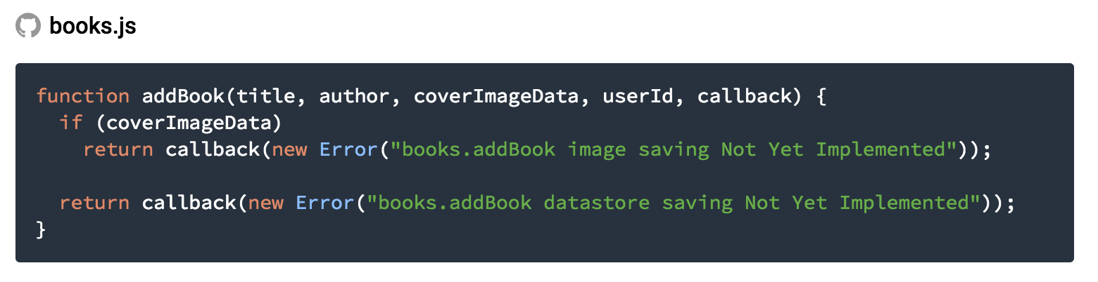
Step 12: Create book
The old code

Slide 28
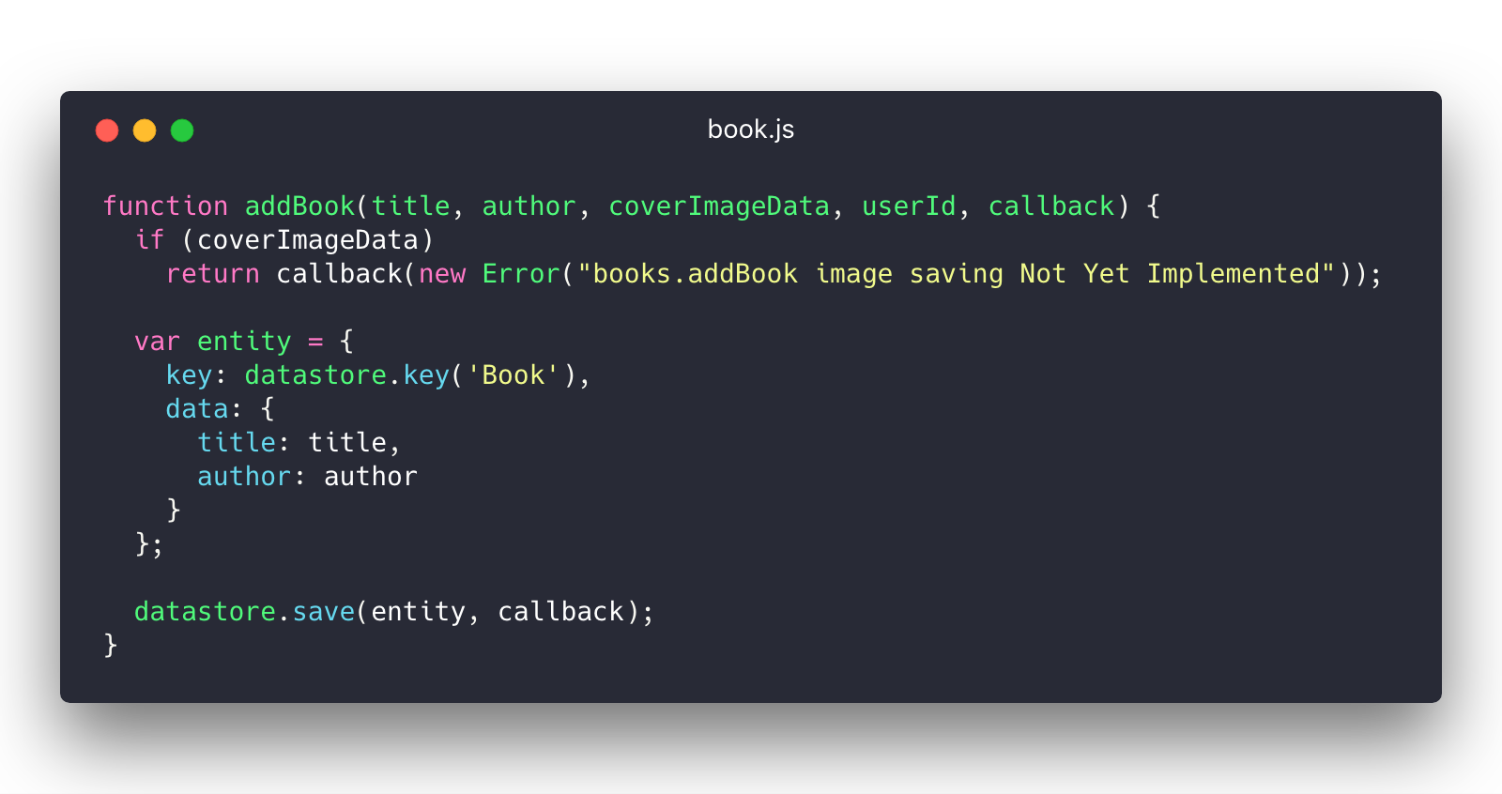
Step 12: Create book
Replace it with this

Slide 29
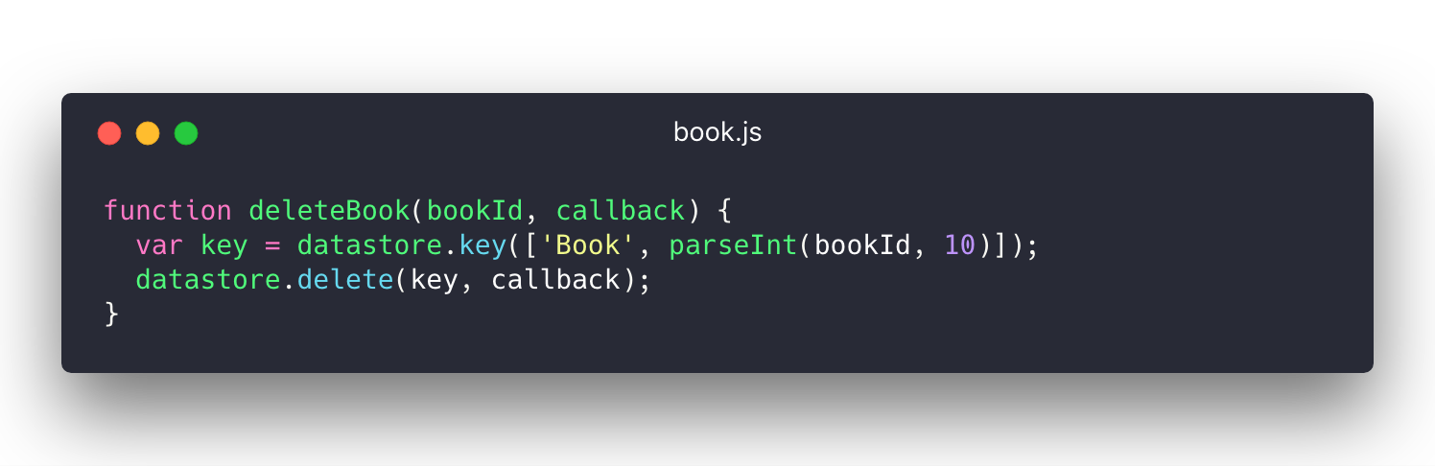
Step 13: Delete book

Slide 30
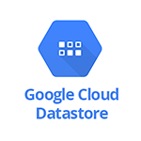
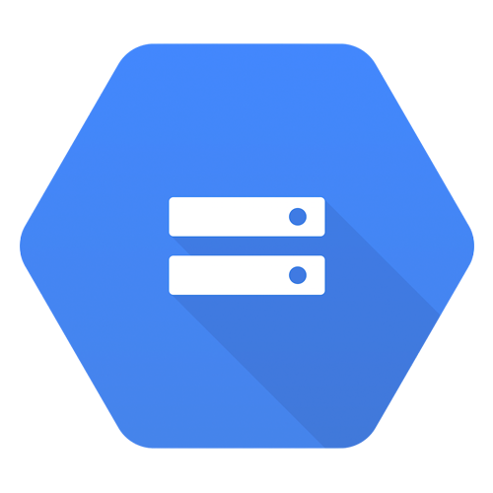
Take a break
Until now, you already learn how to use datastore to keep your data.
App engine to run your node.js application
Next, you’ll learn how to create bucket to store file and use oauth2 to authenticate
GCP Bucket

Slide 31
Step 14: Upload book image to bucket
Create Bucket
Open a new web browser tab and visit Google Cloud Console
Select your Google Cloud Platform project from the dropdown menu
From the left navigation menu, find the Storage section and click Storage
Click Create bucket
Choose a unique bucket name and click Create

Slide 32
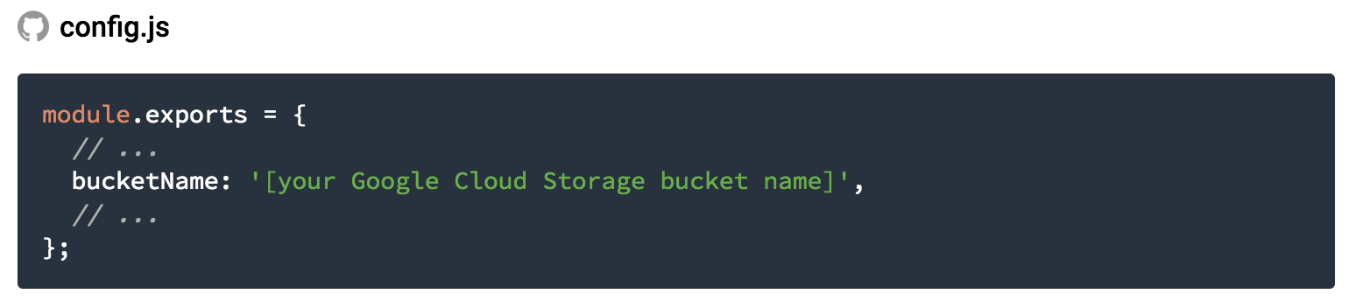
Step 14: Upload book image to bucket
Edit config.js

Slide 33
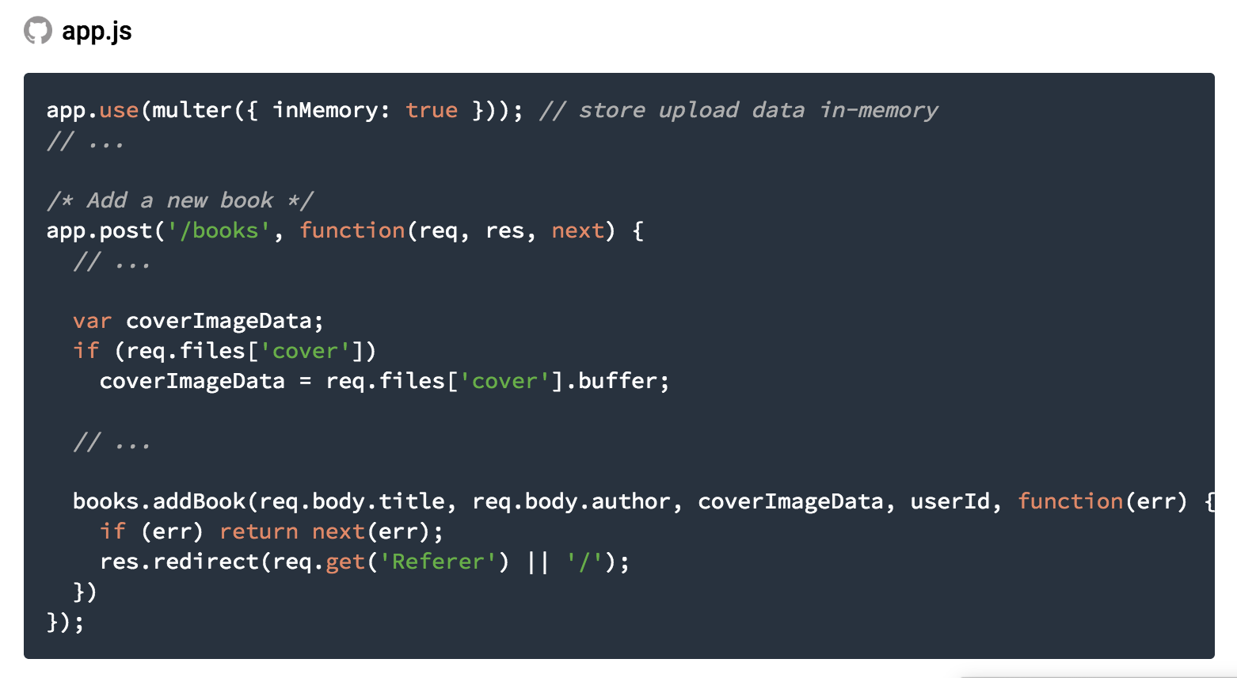
Edit the app.js

Slide 34
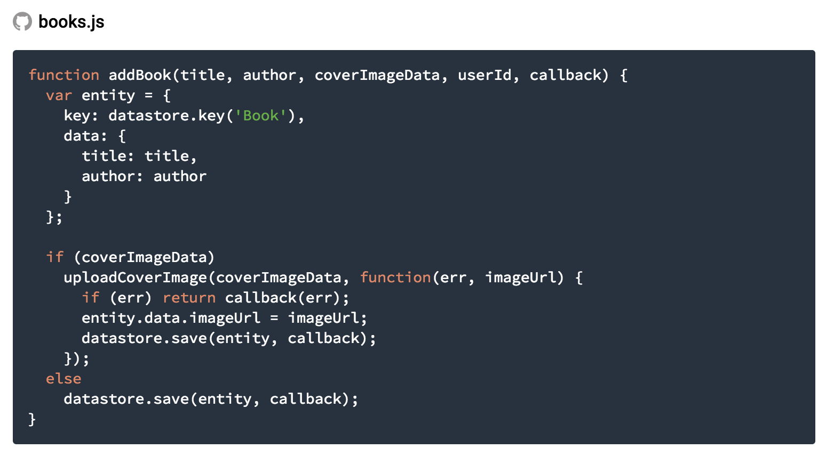
Edit the books.js to handle the cover image.

Slide 35
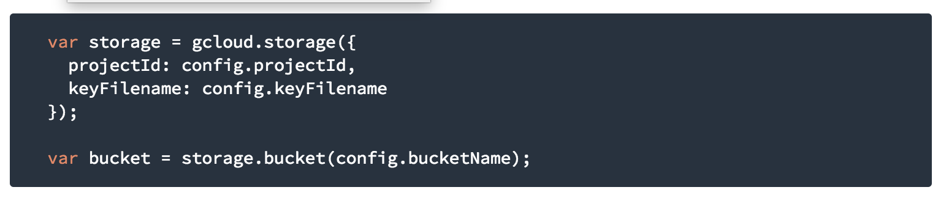
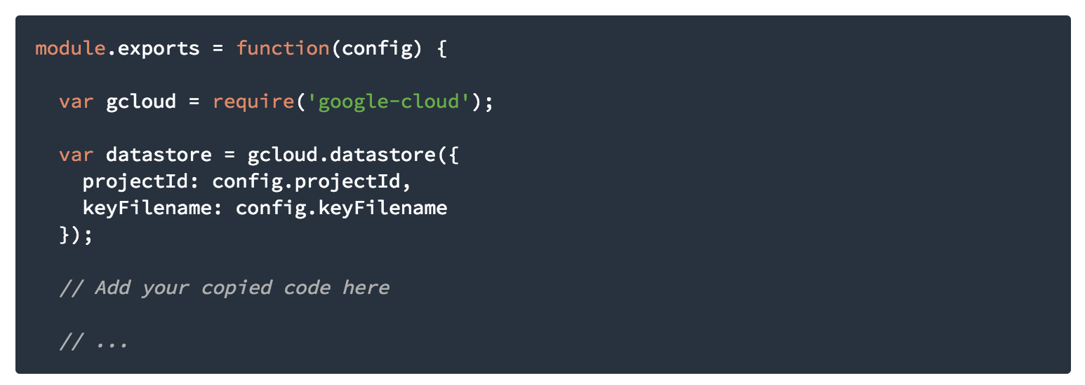
Copy this
Paste it down here to enable your app to use bucket

Slide 36
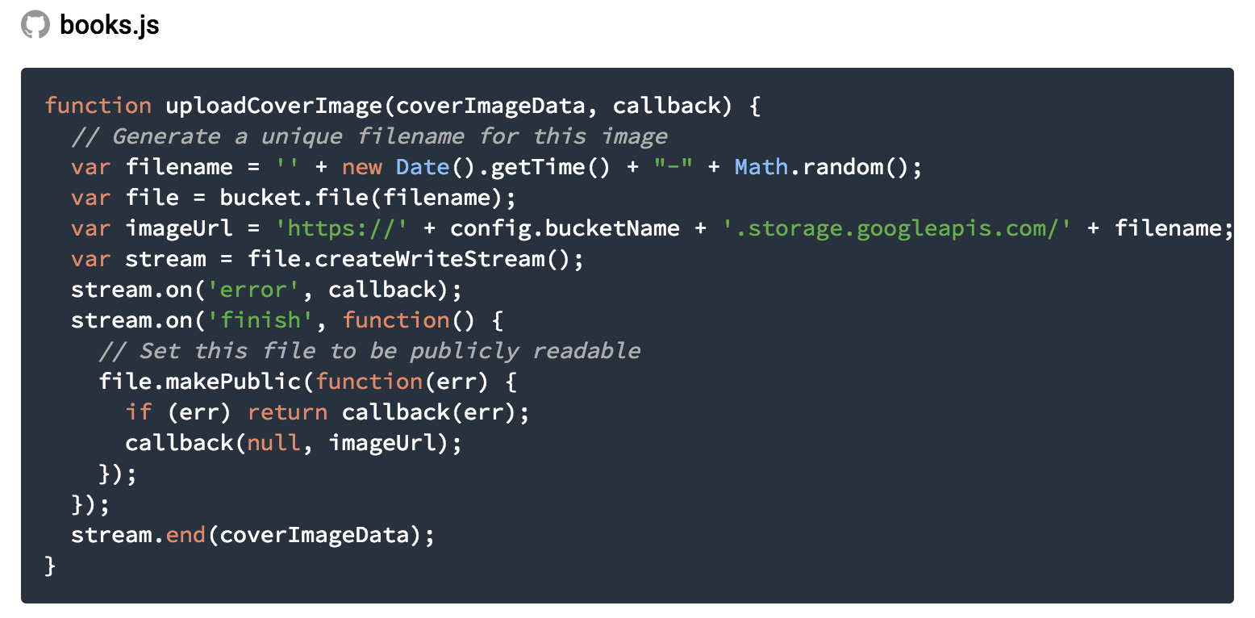
Implement uploadCoverImage function

Slide 37
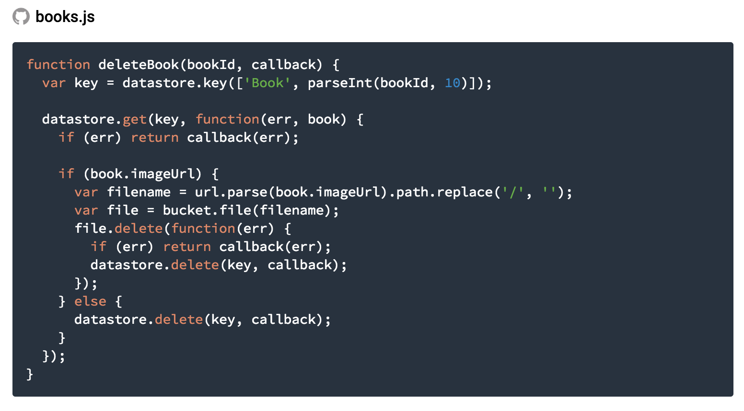
Implement deletebook

Slide 38
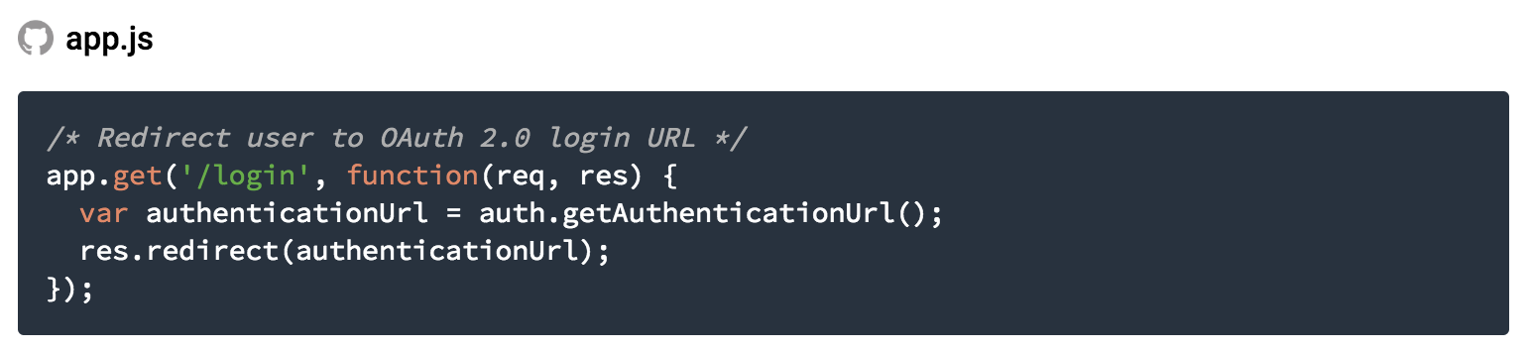
Step 15: Authenticate
Add endpoint to authenticate

Slide 39
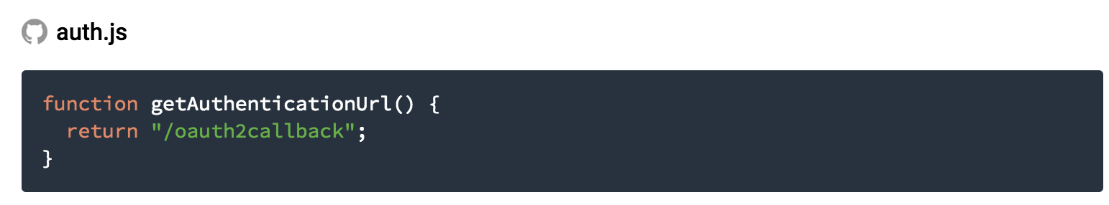
Step 15: Authenticate

Slide 40
Step 16: Setup OAuth 2.0 client
Copy this from the url preview app

Slide 41
Step 16: Setup Oauth 2.0 client
Visit Google Cloud Console. From the left navigation, click APIs & Services > Credentials.
Click Create Credentials > OAuth client ID.
Click the Configure consent screen button.
Choose an email address.
Configure a Product name which identifies your application to users when they sign in
Click Save.
Choose Web application for the Application type.
Paste the URL you copied at the start of this section into Authorized redirect URIs and append /oauth2callback, for example: https://8080-dot-<9 digit number>-dot-devshell.appspot.com/oauth2callback
Click Create.
Make note of the Client ID and Client secret that are displayed. You'll need them for configuration later.

Slide 42
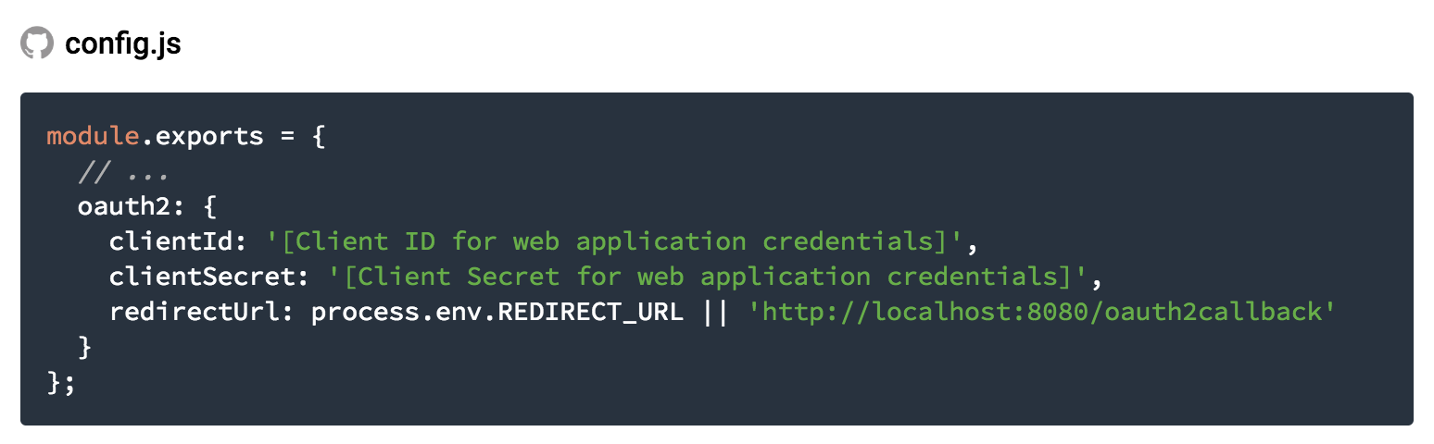
Step 16: Setup Oauth 2.0 client
Update config.js

Slide 43
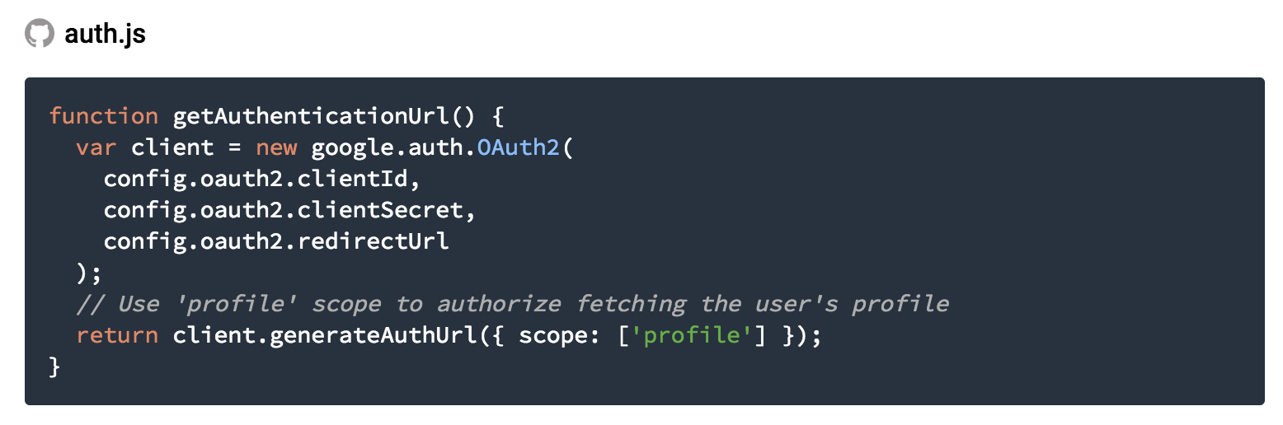
The googleapis node package is Google's officially supported node.js client library for using Google APIs.
Implement authentication function in auth.js

Slide 44
Step 17: fetch User profile
Under APIs & Services > Library > Social APIs search for the "Google+ API"
Click on Google+ API
Click Enable

Slide 45
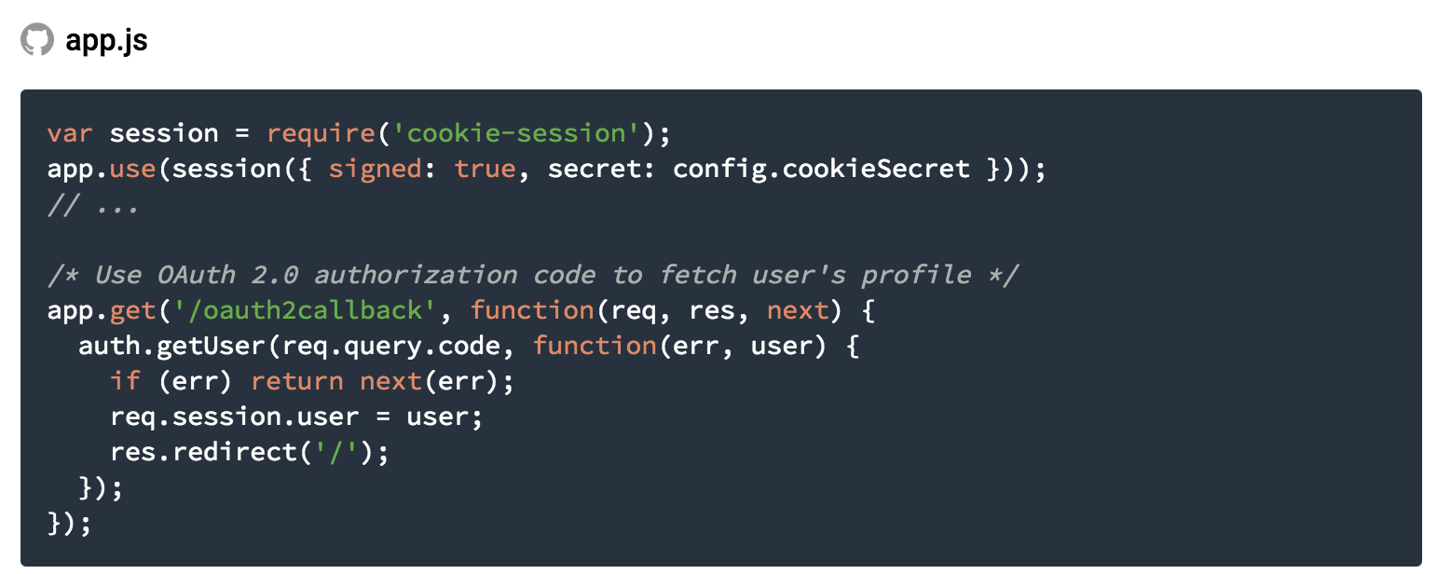
Step 17: fetch User profile

Slide 46
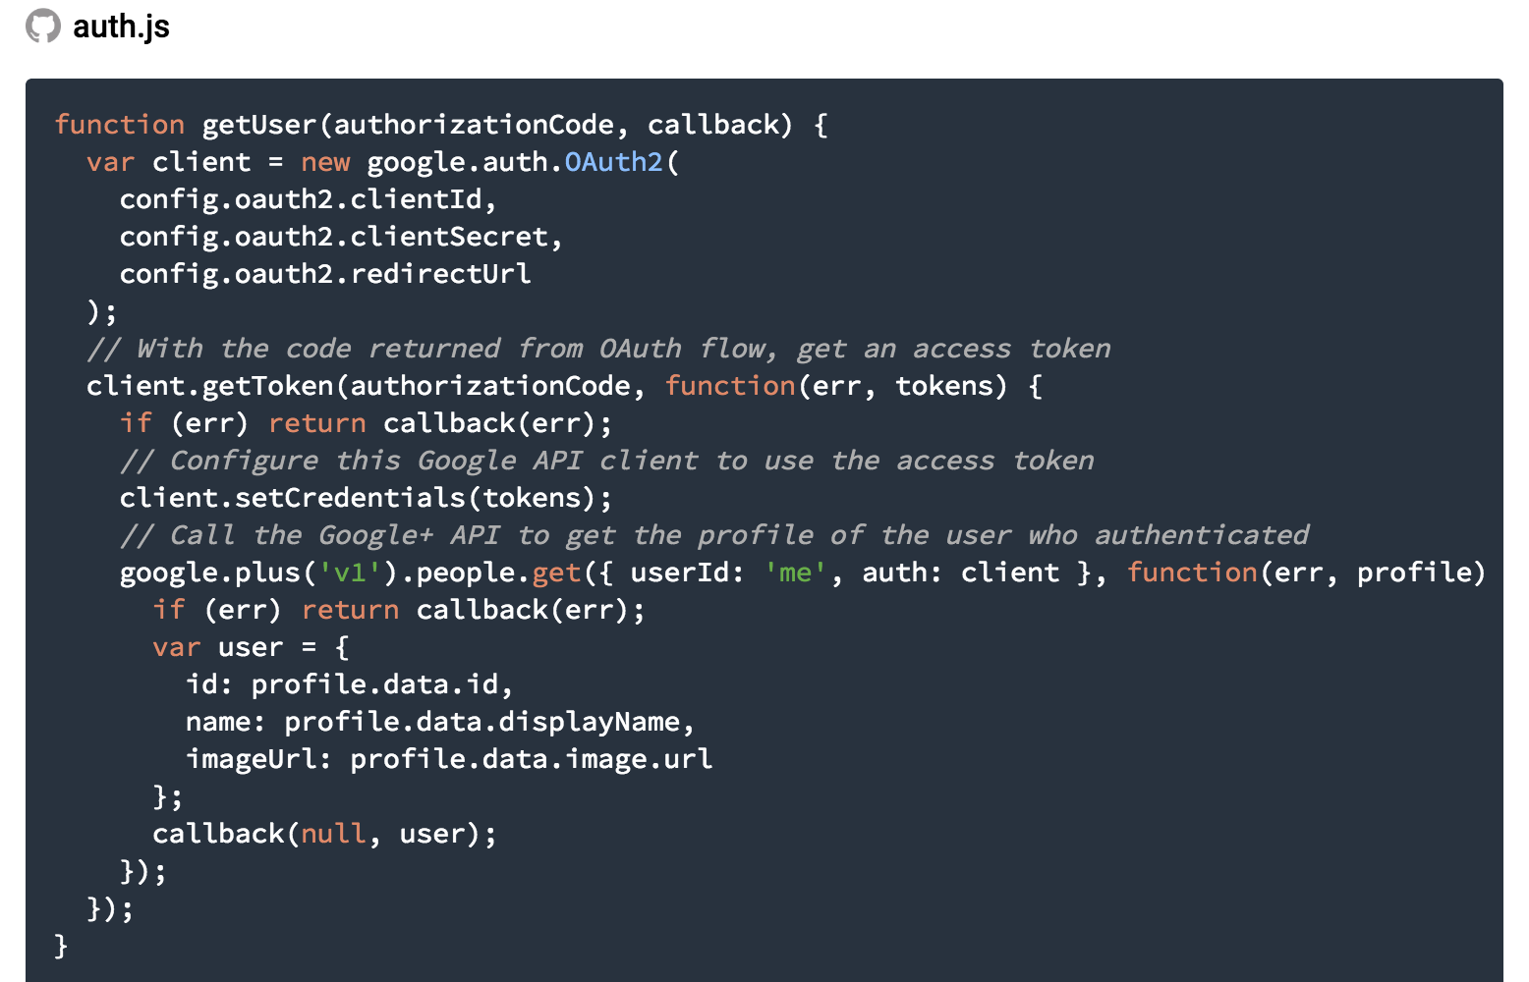
Implement the getUser to return user data

Slide 47
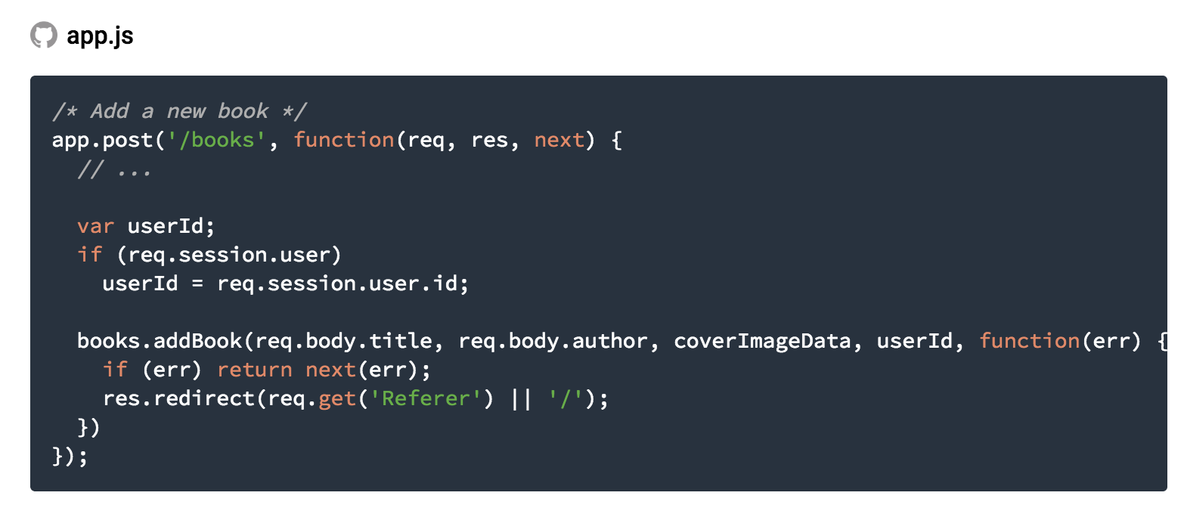
Step 18: Display a user’s book
Implement a new addbook function assign to each user

Slide 48
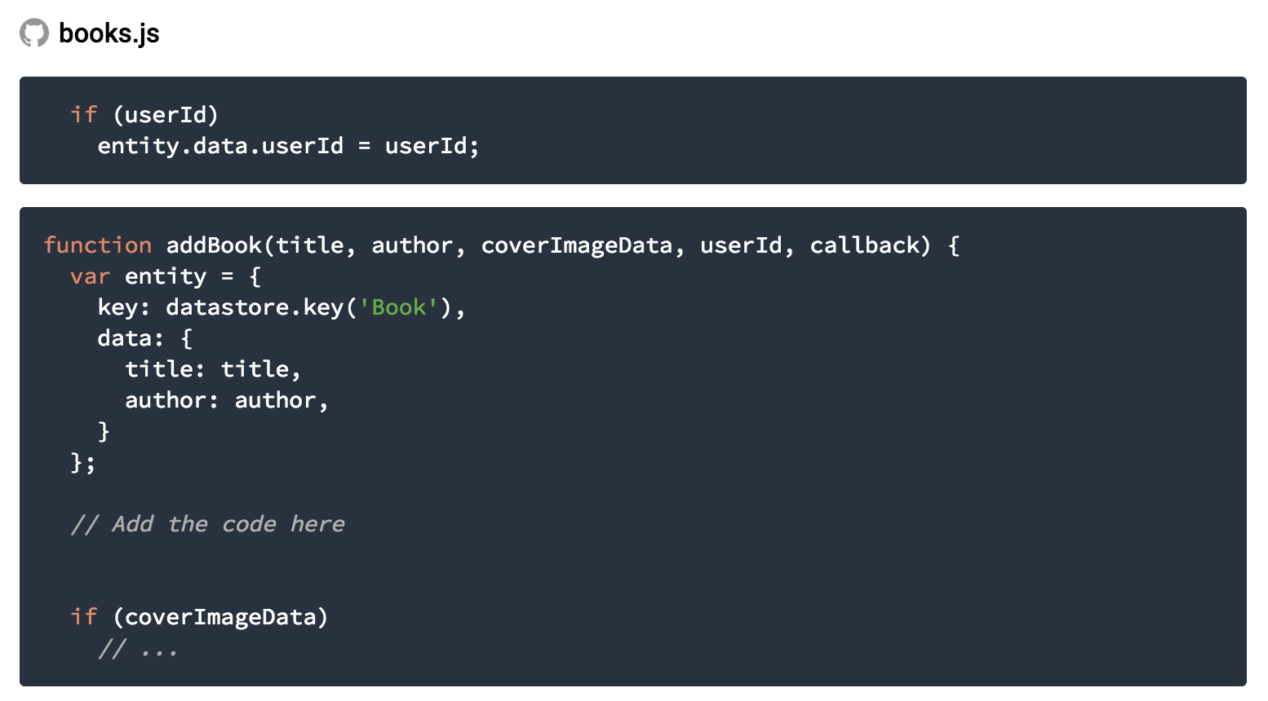
update the entity object in the books.addBook function of books.js to include the userId when provided.

Slide 49
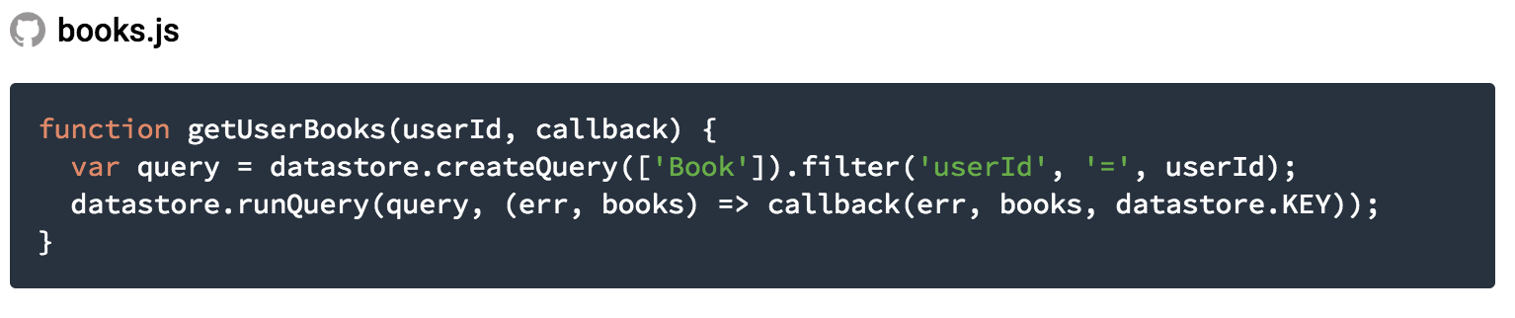
Step 18: Display a user’s book
Implement new getUserBooks function

